Slide 1
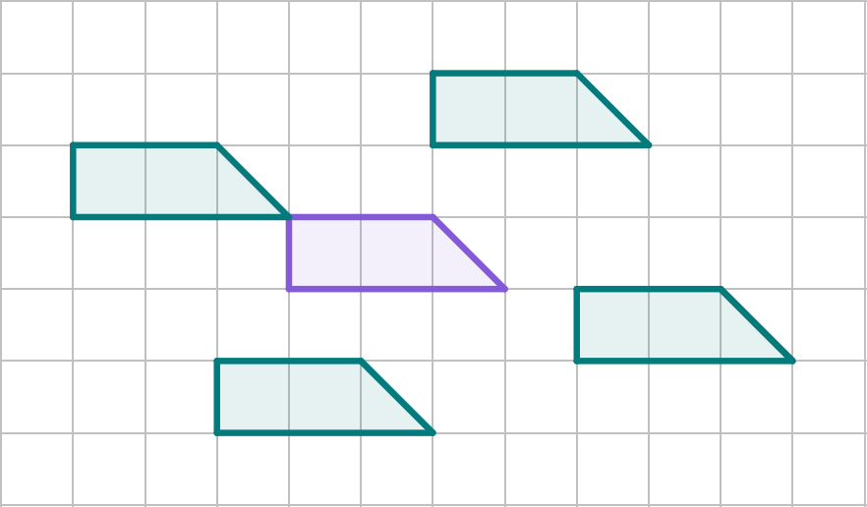
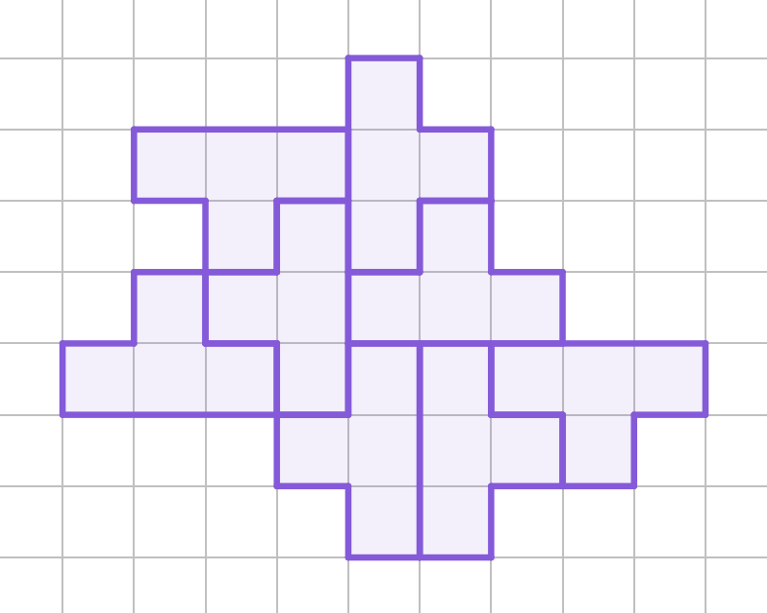
Introduction to translation
Task A: Translation
Draw four more copies of the shape so that they could be a translation.
Example of four you may have drawn.
Write down the pairs that are a translation of each other.
A
B
A and F
B and H
C and G
D and E
C
D
E
F
G
H

Slide 2
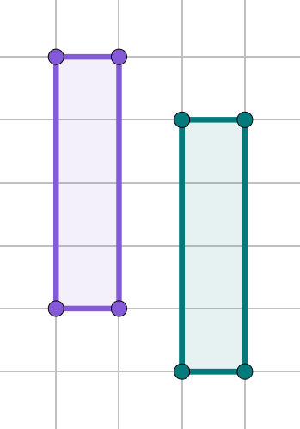
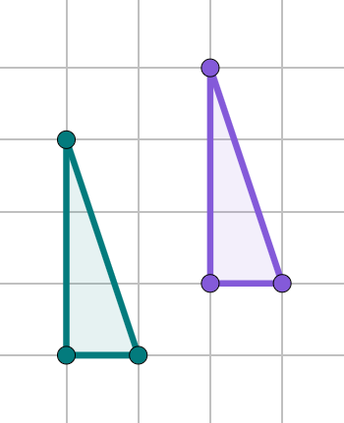
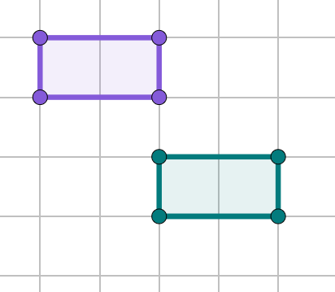
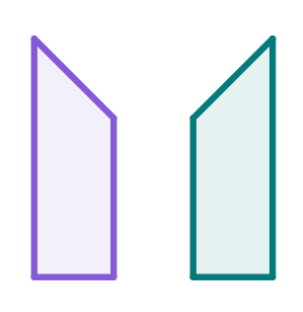


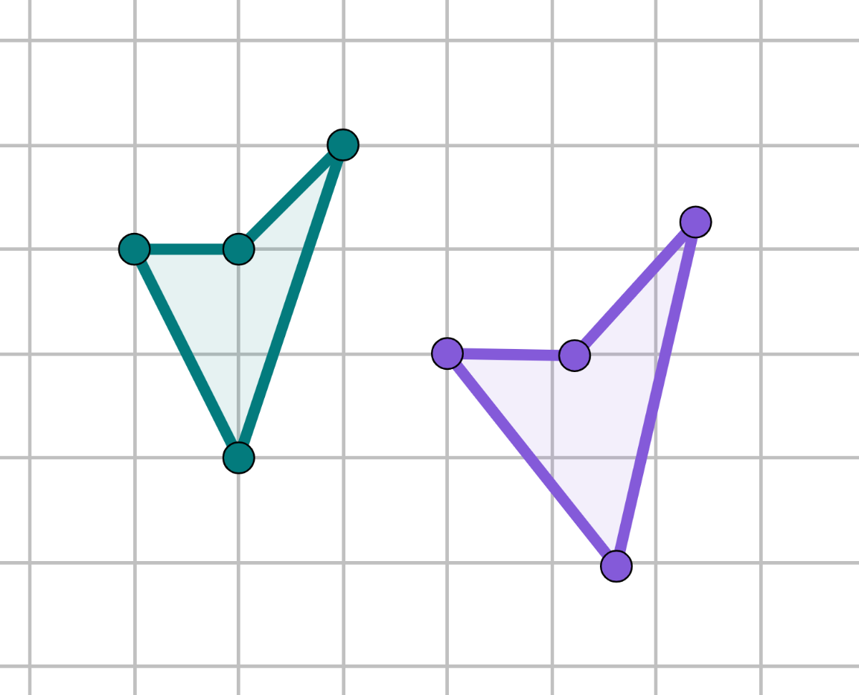
Introduction to translation
Task B: Orientation and position of the image
Complete the shape, so that a translation has taken place.
A
D
b)
Q
c)
Y
X
A′
D′
Q′
W
Z
Y′
X′
R
P
Z′
W′
B
C
R′
P′
B′
C′
Identify which property of the image is incorrect for it to be a translation.
b)
c)
orientation
mirrored
lengths
Complete the table and decide whether a translation has taken place.
Property | Changed - yes/no?
Lengths | yes
Angles | yes
Mirrored | no
Orientation | no
Position | yes
It is not a translation.
Mathematics in Education and Industry.
v2.2

